Slide 1
ELEMENTARY STATISTICS, BLUMAN
TI Calculator – Binomial Distribution
© 2019 McGraw-Hill Education. All rights reserved. Authorized only for instructor use in the classroom. No reproduction or further distribution permitted without the prior written consent of McGraw-Hill Education.

Slide 2
Objectives for this PowerPoint
How to calculate binomial probabilities using the TI Graphing Calculator

Slide 3
Problem
According to the 2012 Pet Ownership and Demographics Sourcebook, 36.5% of US households own at least 1 dog. If 10 US households are randomly selected, what is the probability that at most 4 would own at least 1 dog?

Slide 4
Check Criteria
There are n = 10 trials.
There are only 2 possible outcomes; either a household owns a dog or does not.
Whether a randomly selected household owns a dog has no effect on the probability that another household owns a pet.
The probability of a success remains a constant 0.365 from trial to trial.

Slide 5
Example
According to the 2012 Pet Ownership and Demographics Sourcebook, 36.5% of US households own at least 1 dog. If 10 US households are randomly selected, what is the probability that at most 4 would own at least 1 dog?
P(x ≤ 4) = P(x = 0) + P(x = 1) + P(x = 2) + P(x = 3) + P(x = 4)
Use the binomcdf function to find a binomial probability associated with several values of the random variable, namely the values from zero up to a given value.

Slide 6
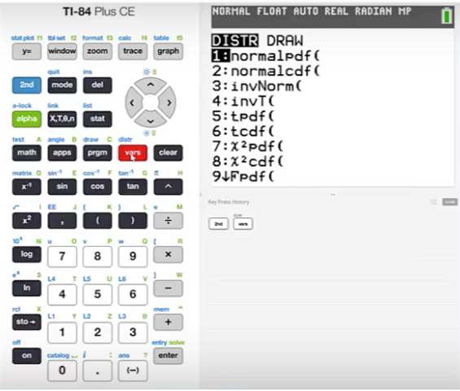
TI Calculator (1)
Press 2nd vars

Slide 7
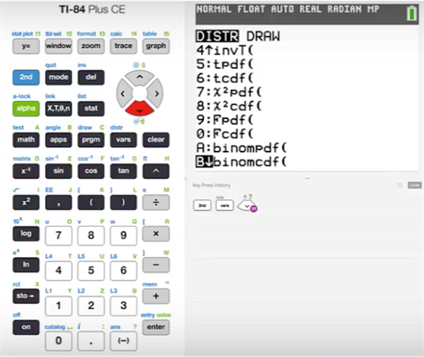
TI Calculator (2)
Cursor down until we find the binomcdf function
Press enter

Slide 8
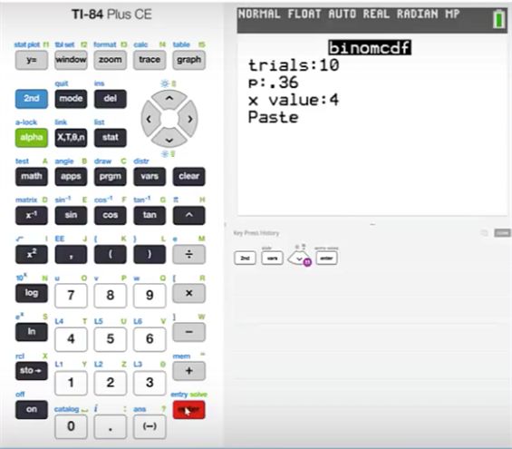
TI Calculator (3)
The number of trials is 10.
The probability of a success is .365.
Find the probability that x would be at least 4.
Cursor down to highlight paste
Press enter.

Slide 9
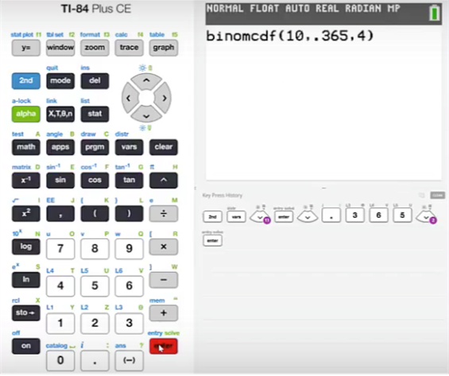
TI Calculator (4)
If you are using a TI graphing calculator that does not present a menu for entering the required values, then you will need to place the values in order.
That order will be n, p, x with commas in between each value.
Press enter

Slide 10
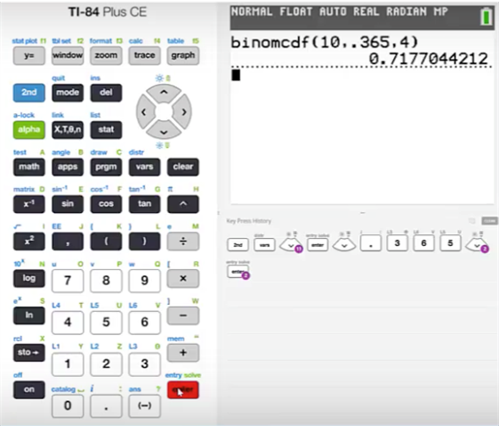
TI Calculator (5)
We will find that this probability is .7177.

Slide 11
Summary
In this PowerPoint, we learned how to calculate binomial probabilities using the TI graphing calculator.

